Slide 1

CAR PRICE ESTIMATION
Under the Guidance of Dr. J RAJESHWAR
( Professor & HOD CSE)
MEHUL KATTELA (17WJ1A05J4)
MERUGU SAITEJA (17WJ1A05J5)
SIVA CHARAN REDDY (16WJ1A05J7)

Slide 2
ABSTRACT
A car price prediction has been a high interest research area, as it requires noticeable effort and knowledge of the field expert. Considerable number of distinct attributes are examined for the reliable and accurate prediction. To build a model for predicting the price of used cars in Bosnia and Herzegovina, we applied machine learning technique (Linear Regression). However, the mentioned technique was applied to work as an ensemble. The data used for the prediction was collected from the web portal autopijaca.ba. The prediction model was integrated in Python. Furthermore, the model was evaluated using test data and the accuracy of 89.86% was obtained.

Slide 3
INTRODUCTION
Car price prediction is somehow interesting and popular problem. Accurate car price prediction involves expert knowledge, because price usually depends on many distinctive features and factors. Typically, most significant ones are brand and model, age, horsepower and mileage. The fuel type used in the car as well as fuel consumption per mile highly affect price of a car due to a frequent changes in the price of a fuel. Different features like exterior color, door number, type of transmission, dimensions, safety, air condition, interior, whether it has navigation or not will also influence the car price. In this project, we have applied linear regression method in order to achieve higher precision of the used car price prediction.

Slide 4
EXISTING SYSTEM:
In existing system they are implementing car price prediction system using k-means algorithm.
Existing System Disadvantages:
Less accuracy
Difficult to predict
With global clusters, it doesn’t work well

Slide 5
PROPOSED SYSTEM:
In this system we are implementing effective car price prediction system using linear regression. We can give the input as in CSV file or manually entry to the system. After taking input the algorithms applied. After accessing data set the operation is performed and effective results are obtained.
Proposed System Advantages:
Easy to predict
High accuracy rate

Slide 6
LITERATURE SURVEY:
Title: Predicting the price of used cars using machine learning techniques.
Author: Pudaruth
Year:2017
Description: According to a World Economic Forum’s report, AI-enabled automation will generate 133 million new jobs globally by 2022. And in India itself, the demand for AI talent pool is expected to skyrocket with the government’s steps towards digitization, and multiple organizations accelerating their digital transformation initiatives. Are you ready to ride the wave? The BITS Pilani 11-month online PG Programme in AI & ML is designed to help working professionals like you to develop an understanding of AI & ML and its various building blocks.

Slide 7
Title: An expert system of price forecasting for used cars using adaptive neurofuzzy inference.
Year: 2009
Author: Wu, J. D., Hsu, C. C., & Chen, H. C.
Description: An expert system for used cars price forecasting using adaptive neuro-fuzzy inference system (ANFIS) is presented in this paper. The proposed system consists of three parts: data acquisition system, price forecasting algorithm and performance analysis. The effective factors in the present system for price forecasting are simply assumed as the mark of the car, manufacturing year and engine style. Further, the equipment of the car is considered to raise the performance of price forecasting. In price forecasting, to verify the effect of the proposed ANFIS, a conventional artificial neural network (ANN) with back-propagation (BP) network is compared with proposed ANFIS for price forecast because of its adaptive learning capability. The ANFIS includes both fuzzy logic qualitative approximation and the adaptive neural network capability. The experimental result pointed out that the proposed expert system using ANFIS has more possibilities in used car price forecasting.

Slide 8
REQUIREMENTS ENGINEERING
GENERAL
These are the requirements for doing the project. Without using these tools and software’s we can’t do the project. So we have two requirements to do the project. They are
1. Hardware Requirements.
2. Software Requirements.
HARDWARE REQUIREMENTS
The hardware requirements may serve as the basis for a contract for the implementation of the system and should therefore be a complete and consistent specification of the whole system. They are used by software engineers as the starting point for the system design.

Slide 9
HARDWARE REQUIREMENTS
PROCESSOR : DUAL CORE 2 DUOS.
RAM : 4GB DD RAM
HARD DISK : 250 GB

Slide 10
SOFTWARE REQUIREMENTS
The software requirements document is the specification of the system. It should include both a definition and a specification of requirements. It is a set of what the system should do rather than how it should do it. The software requirements provide a basis for creating the software requirements specification. It is useful in estimating cost, planning team activities, performing tasks and tracking the teams and tracking the team’s progress throughout the development activity.
Operating System : Windows 10
Platform : Jupyter Notebook
Programming Language : Python

Slide 11
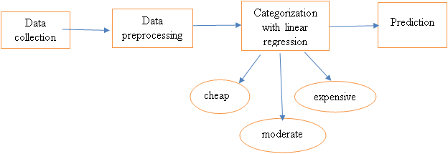
System Architecture

Slide 12
OBJECTIVE
To build a model for predicting the price of used cars in Bosnia and Herzegovina. The data used for the prediction was collected from the web portal autopijaca.ba.
Linear regression algorithm has been used for this implementation.

Slide 13
Uml Diagrams
Use Case Diagram
Notes:
EXPLANATION:
The main purpose of a use case diagram is to show what system functions are performed for which actor. Roles of the actors in the system can be depicted. The above diagram consists of user as actor. Each will play a certain role to achieve the concept.

Slide 14
Class Diagram
Notes:
EXPLANATION:
In this class diagram represents how the classes with attributes and methods are linked together to perform the verification with security. From the above diagram shown the various classes involved in our project.

Slide 15
Object Diagram
Notes:
EXPLANATION:
In the above digram tells about the flow of objects between the classes. It is a diagram that shows a complete or partial view of the structure of a modeled system. In this object diagram represents how the classes with attributes and methods are linked together to perform the verification with security.

Slide 16
State Diagram
Notes:
EXPLANATION:
State diagram are a loosely defined diagram to show workflows of stepwise activities and actions, with support for choice, iteration and concurrency. UML, activity diagrams can be used to describe the business and operational step-by-step workflows of components in a system. UML activity diagrams could potentially model the internal logic of a complex operation. In many ways UML activity diagrams are the object-oriented equivalent of flow charts and data flow diagrams (DFDs) from structural development.

Slide 17
Sequence Diagram
Notes:
EXPLANATION:
A sequence diagram in Unified Modeling Language (UML) is a kind of interaction diagram that shows how processes operate with one another and in what order. It is a construct of a Message Sequence Chart. A sequence diagram shows object interactions arranged in time sequence. It depicts the objects and classes involved in the scenario and the sequence of messages exchanged between the objects needed to carry out the functionality of the scenario.

Slide 18
Collaboration Diagram
Notes:
EXPLANATION:
A collaboration diagram, also called a communication diagram or interaction diagram, is an illustration of the relationships and interactions among software objects in the Unified Modeling Language (UML). The concept is more than a decade old although it has been refined as modeling paradigms have evolved.

Slide 19
Component Diagram:
Notes:
EXPLANATION:
In the Unified Modeling Language, a component diagram depicts how components are wired together to form larger components and or software systems. They are used to illustrate the structure of arbitrarily complex systems. User gives main query and it converted into sub queries and sends through data dissemination to data aggregators. Results are to be showed to user by data aggregators. All boxes are components and arrow indicates dependencies.

Slide 20
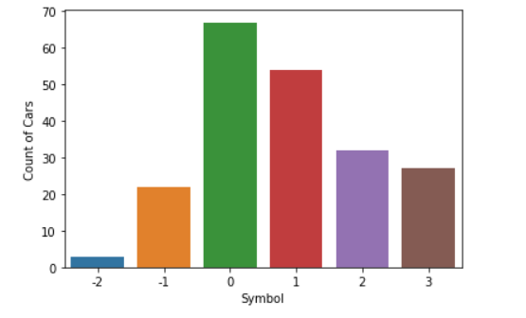
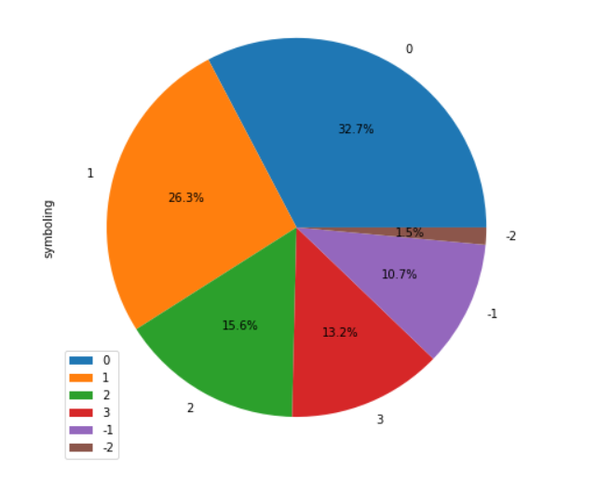
SNAPSHOTS
Notes:
EXPLANATION:
Analysing symbols and count of cars with the help of bar graph and pie chart.

Slide 21
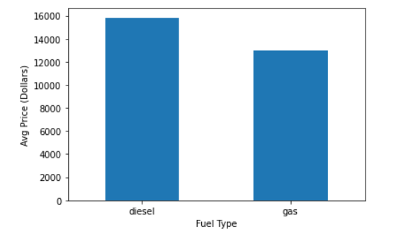
Notes:
EXPLANATION:
Comparing diesel and gad fuel type cars based on their average price in dollars.

Slide 22
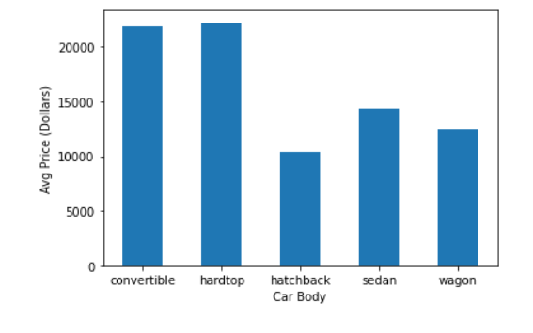
Notes:
EXPLANATION:
Above bar graph compares car body types with respect to pricing in dollars.

Slide 23
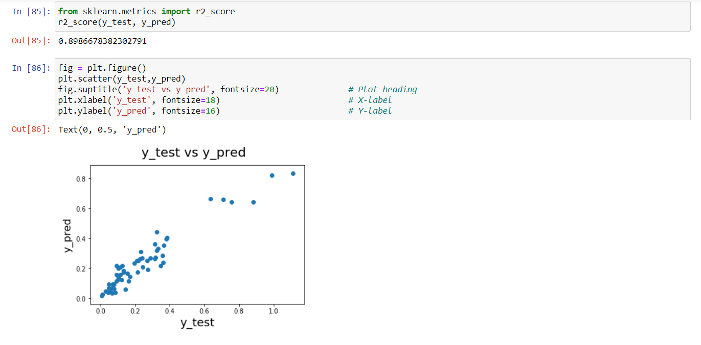
Notes:
EXPLANATION:
The above picture shows the accuracy of implemented model (89.86)

Slide 24
CONCLUSION
Car price prediction can be a challenging task due to the high number of attributes that should be considered for the accurate prediction. The major step in the prediction process is collection and preprocessing of the data.
Data cleaning is one of the processes that increases prediction performance, yet insufficient for the cases of complex data sets as the one in this research. Applying k-means clustering algorithm on the data set, accuracy was less than 50%. Therefore the linear regression algorithm has been proposed and this algorithm gains accuracy of 89.86%. This is significant improvement compared to k-means clustering approach. However, the drawback of the proposed system is that linear regression is susceptible to overfitting.

Slide 25
FUTURE ENHANCEMENT
Although, this system has achieved astonishing performance in car price prediction problem our aim for the future research is to test this system to work successfully with various data sets. We will extend our test data with eBay and OLX used cars data sets and validate the proposed approach.

Slide 26
Thank you.
Any queries?

